Slide 1
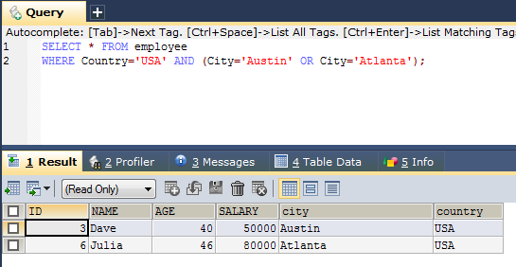
Combining AND, OR and NOT Operators
We can also combine the AND, OR and NOT operators.
The following SQL statement selects all fields from "employee" where country is "USA" AND city must be "Austin" OR "Atlanta" (use parenthesis to form complex expressions):
SELECT * FROM employee
WHERE Country='USA' AND (City='Austin' OR City='Atlanta');

Slide 2
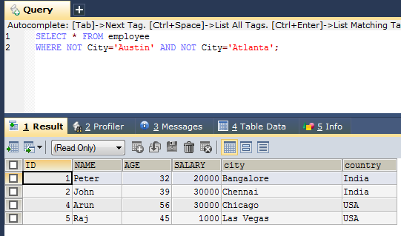
Combining AND, OR and NOT
The following SQL statement selects all fields from "employee" where City is NOT "Austin" and NOT "Atlanta":
SELECT * FROM employee
WHERE NOT City='Austin' AND NOT City='Atlanta';

